Slide 1
Parallel and Distributed Computing
Dr. Hammad Afzal
Military College of Signals
National University of Sciences and Technology, Pakistan
Spring, 2011
hammad.afzal@mcs.edu.pk
https://sites.google.com/a/mcs.edu.pk/codteem/

Slide 2
Today’s talk
Chapter 1 (Contd…)
Resource sharing and the web
The World Wide Web
HTML
URL
HTTP
Dynamic Pages
Web Services

Slide 3
The World Wide Web
An evolving system for publishing and accessing resources and services on Internet.
Require a Browser
View documents
Listen audio
View video streams &
interact with an unlimited set of services.
Born at CERN: European Centre for Nuclear Research in 1989.
Primarily for exchanging documents between scientists.
Have standards for Communication and Document
For example: HTTP , HTML
Notes:
This is an evolving sys for publishing & accessing resources & services across the internet
The web began life at the European centre for nuclear research (CERN), Switzerland, in 1989 as a vehicle for exchanging documents between community of physicists connected by the internet.
Hypertext linked documents -- HTML
Require a browser to view documents of many types, listen audio and view video streams & interact with an unlimited set of services.

Slide 4
The World Wide Web (2)
Web is an Open System
Can be extended and implemented in new ways without disturbing its existing functionality.
Open with respect to
1. Given standards for document and communication and many implementations of Browsers and Web servers; on different platforms.
2. Many types of resources can be published and shared on it.
Files, Images, Videos.
Browser reads HTML tags and renders page on client screen.
Browsers are designed to accommodate new content-presentation functionality in the form of ‘helper’ app and ‘plug-ins’
3. Encompass new services without changing its basic architecture
Electronic purchasing of goods.
Notes:
Open: Can be extended and implemented in new ways without disturbing its existing functionality.
Based on Communication standard and document standard.
Many types of browsers, many types of servers
The web is open w.r.t. the types of ‘resource’ that can be published & shared on it.
Browsers are designed to accommodate new content-presentation functionality in the form of ‘helper’ app and ‘plug-ins’
Browser reads HTML tags and renders page on client screen
The web has moved beyond simple data resources to encompass services, such as electronic purchasing of goods. It has evolved without changing its basic architecture.

Slide 5
The World Wide Web (3)
The web is based on three main standard technological components.
HTML
A language for specifying the contents & layout of pages on the web
Tags based mark up language
URL
To identify documents & other resources stored as part of web
Scheme: scheme-specific-location
HTTP
Protocol by which browsers & other clients fetch documents
Notes:
HTML: A language for specifying the contents & layout of pages on the web
Tags based mark up language
URL: To identify documents & other resources stored as part of web
Scheme: scheme-specific-location
HTTP: Protocol by which browsers & other clients fetch documents

Slide 6
Hyper Text Markup Language HTML
HTML is a standard language used to develop web documents.
Tags
A directive or token enclosed in angle braces.
To define certain directives. Paragraphs, headings, anchors
Hyper Text
Text linked with some other document through a hyper link.
Markup means anything extra which is needed to present text.
For example, to write a line of bold text, we write <B>Text</B>. These tags is markup.
Notes:
HTML (Hyper Text Markup Language) is a standard language used to develop web documents.
It uses tags to define certain directives. A tag is some directive or token enclosed in angle braces.
Hyper Text means text linked with some other document through a hyper link.
Markup means anything extra which is needed to present text. For example, to write a line of bold text, we write <B>Text</B>. These tags is markup.

Slide 7
Hyper Text Markup Language HTML
No compilation:
Its source is parsed and displayed by a web browser.
Parsing
Identify the given tags and display the data given in the tags according to there predefined meanings.
Hyperlinks
<A HREF=http://cnn.com>Go to CNN</A> hyperlinks the specified text with the location mentioned in HREF attribute.
If you want to jump to a particular location within the displayed page then we define <A Name=“Tag”>Text to go</A> where we want to jump to. At FROM location, we write <A HREF=“#Tag”>GO</A>
<HTML>
<Head><Title>This is first page</title></head>
<Body><p>Hello World!
<img src=earth.jpg>
</body></html>
Notes:
An HTML document need not to compile. Its source is parsed and displayed by a web browser.
Parsing means that we identify the given tags and display the data given in the tags according to there predefined meanings.

Slide 8
Uniform Resource Locator URL
To identify a resource
To enable the browser to locate that resource.
Browsers examine the URL’S in order to fetch the corresponding resources from the web servers.
URL Entry:
User types
Clicks on a URL of a link or image etc.
Notes:
The purpose of a Uniform Resource locator is to identify a resource in such a way as to enable the browser to locate that resource. Browsers examine the URL’S in order to fetch the corresponding resources from the web servers.
Sometimes users type a url otherwise browsers look up the corresponding url when the user clicks on a link e.g. an image.
Every URL has two top level components.
Scheme: scheme-specific-location
First indicates which type of resource browser is going to deal with.
Second indicates the location where the resource is present.
World wide web is open w.r.t type of resources.

Slide 9
Uniform Resource Locator URL
Every URL has two top level components.
Scheme: scheme-specific-location
First indicates which type of resource browser is going to deal with.
Second indicates the location where the resource is present.
Examples
mailto:hammad.afzal@mcs.edu.pk
ftp://ftp.downloadIt.com
http://www.mcs.edu.pk/
Notes:
The purpose of a Uniform Resource locator is to identify a resource in such a way as to enable the browser to locate that resource. Browsers examine the URL’S in order to fetch the corresponding resources from the web servers.
Sometimes users type a url otherwise browsers look up the corresponding url when the user clicks on a link e.g. an image.
Every URL has two top level components.
Scheme: scheme-specific-location
First indicates which type of resource browser is going to deal with.
Second indicates the location where the resource is present.
World wide web is open w.r.t type of resources.

Slide 10
Uniform Resource Locator URL
HTTP URLS are the most widely used for fetching resources using the standard http protocol.
http://servername[:port][/pathNameOnServer][?arguments]

Slide 11
URLS (Web servers and web browsers)
http://www.google.comlsearch?q=distibuted
www.google.com
Web servers
Browsers
www.cdk3.net
Internet
http://www.cdk3.net/
www.w3c.org
File system of
http://www.w3c.org/Protocols/Activity.html
www.w3c.org
Protocols
Activity.html
Web documents use the HTML representation instead of specifying a detailed document format, HTML allows a document to contain general guidelines for display, and allows a browser to choose details. Consequently, two browsers may display an HTML document differently

Slide 12
Hypertext Transfer Protocol (http)
Defines the ways in which the client and servers interact with each other to exchange information with each other. HTTP has different main features (refer book):
Request-reply interaction
Content types (MIME type: Multipurpose Internet Mail Extensions)
(Details on Next Slides)
One resource per request
Simple access control—password protected
Publishing a resource
(From Book)
Notes:
Defines the ways in which the client and servers interact with each other to exchange information with each other. HTTP has different main features (refer book):
Request-reply interaction
Content types (MIME type: Multipurpose Internet Mail Extensions)
One resource per request
Simple access control—password protected
Publishing a resource

Slide 13
Hypertext Transfer Protocol (http)
Request-reply interaction
A client-server protocol.
Browser sends HTTP request messages for HTML pages to the server.
Web servers handle these requests by returning response messages.
If request is granted then along with the approval response message the contents of the webpage are also being sent.
Client uses domain names instead of IP address.
www.yahoo.com/carfinance.html
Then is it converted to IP address at the back end?
Notes:
Request-reply interaction
Hyper Text Transfer Protocol (HTTP) is a client-server protocol.
Whenever you surf the web, your browser will be sending HTTP request messages for HTML pages to the server.
Web servers handle these requests by returning response messages.
Client making an HTTP request is referred as user agent. The responding server is called the origin server.

Slide 14
Hypertext Transfer Protocol (http)
Content Types
MIME
Browser sends its preferred content types to server.
E.g. Maybe able to handle GIF but not JPG
Server considers request and returns accordingly if possible.
Server also tells content type in response.
Examples,
if content type is image/GIF, browser renders and show the image.
If content type is ‘application/zip’ browser may start an external application
Notes:
Request-reply interaction
Hyper Text Transfer Protocol (HTTP) is a client-server protocol.
Whenever you surf the web, your browser will be sending HTTP request messages for HTML pages to the server.
Web servers handle these requests by returning response messages.
Client making an HTTP request is referred as user agent. The responding server is called the origin server.

Slide 15
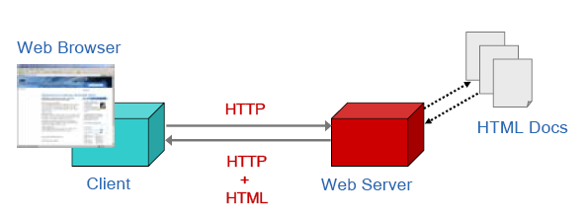
Hypertext Transfer Protocol (http)

Slide 16
The World Wide Web (Advanced)
Dynamic and Interactive web page
A combination of technologies to make Web pages dynamic.
For many people: A combination of HTML 4.0, Style Sheets and JavaScript
HTML→ Contents
CSS → Appearance
Javascript → Interactivity
Notes:
Static, Dynamic and Interactive web page
Dynamic HTML is a combination of technologies to make Web pages dynamic. To most people Dynamic HTML means a combination of HTML 4.0, Style Sheets and JavaScript
HTML→ Contents
CSS → Appearance
Javascript → Interactivity
Send Request with Get and Post methods
Server (CGI or active pages) & Client side execution

Slide 17
The World Wide Web (Advanced) (Details from Book)
Dynamic and Interactive web page
Examples:
Server (CGI or active pages) & Client side execution
Send Request with Get and Post methods
Search Engines
Downloaded Code
JavaScript, Applet
CGI: Common Gateway Interface
Notes:
Static, Dynamic and Interactive web page
Dynamic HTML is a combination of technologies to make Web pages dynamic. To most people Dynamic HTML means a combination of HTML 4.0, Style Sheets and JavaScript
HTML→ Contents
CSS → Appearance
Javascript → Interactivity
Send Request with Get and Post methods
Server (CGI or active pages) & Client side execution

Slide 18
The World Wide Web (Advanced)
Web Services
Programmatic access to Web resources.
(Details Later while studying Web Services)
Notes:
If resource is deleted or removed.
Dangling links, lost in hyperspace
Users following confusingly many disparate links
Search Engines
Search engines are a useful complement to link-following as a means of finding info on web-but imperfect at producing what the user specifically intends.
Resource Description Framework: Semantic Web

Slide 19
Extensible Markup Language XML
There is an increase need to exchange many types of structured data on the web – HTML is limited; only for information browsing
XML has been designed as a way of representing data in standard, structured, application-specific form
XML was designed to describe data and to focus on what data is.
HTML was designed to display data and to focus on how data looks.
HTML is about displaying information, while XML is about describing information
<message> <to>Dave</to> <from>Susan</from> <subject>Reminder</subject> <text>Buy milk on the way home.</text> </message>

Slide 20
Extensible Markup Language XML
XML: a meta-language for describing data
XML stands for Extensible Markup Language
XML is a markup language much like HTML
XML was designed to describe data
XML tags are not predefined in XML. You must define your own tags
XML uses a Document Type Definition (DTD) or an XML Schema to describe the data
XML with a DTD or XML Schema is designed to be self-descriptive

Slide 21
Web Problems
Scaling Problems
Many hits per second for popular Web servers
Response to users is slow
Solution:
Caching: in browsers to alleviate these effects
Proxy Servers
Notes:
As a system architecture the web faces problems of scale. Popular web servers may experience many hits per second and as a result the response to users is slow
The use of caching in browsers to alleviate these effects
The web client-server architecture means that it has no efficient means of keeping users up to date with the latest versions of pages.
Browser reload buttons are to be clicked for latest information & browsers are forced to communicate with servers to check whether a local copy of a resource is still valid.
A web page is not always a satisfactory user interface
Applets components are used with an increase in the download time.

Slide 22
Web Problems
The Web Client-Server Architecture means that it has no efficient means of keeping users up to date with the latest versions of pages.
Pull Vs Push
Pull: Browser reload buttons are to be clicked for latest information & browsers are forced to communicate with servers to check whether a local copy of a resource is still valid.
Push Model
(anyone with smart-phones?)
Notes:
As a system architecture the web faces problems of scale. Popular web servers may experience many hits per second and as a result the response to users is slow
The use of caching in browsers to alleviate these effects
The web client-server architecture means that it has no efficient means of keeping users up to date with the latest versions of pages.
Browser reload buttons are to be clicked for latest information & browsers are forced to communicate with servers to check whether a local copy of a resource is still valid.
A web page is not always a satisfactory user interface
Applets components are used with an increase in the download time.

Slide 23
Web Problems
If resource is deleted or removed.
Dangling links, lost in hyperspace
Users following confusingly many disparate links
Search Engines
Search engines are a useful complement to link-following as a means of finding info on web-but imperfect at producing what the user specifically intends.
Resource Description Framework: Semantic Web
Web of linked metadata resources is Semantic Web
Notes:
If resource is deleted or removed.
Dangling links, lost in hyperspace
Users following confusingly many disparate links
Search Engines
Search engines are a useful complement to link-following as a means of finding info on web-but imperfect at producing what the user specifically intends.
Resource Description Framework: Semantic Web

Slide 24
Additional References

Slide 25
TAGS

Slide 26
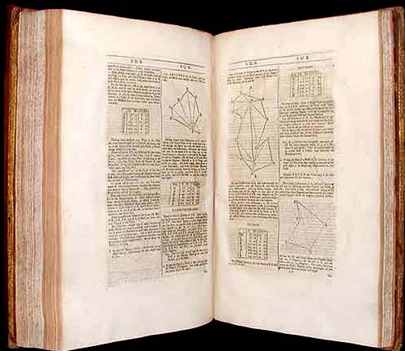
a tag
a data attached to an object
origins of geometry

Slide 27

tagging
mark
describe
comment
group
etc.
is not a new activity

Slide 28

another tag
in the web?
<a>

Slide 29
Semantic Web
Provides machine understandability by adding machine processable semantics to conventional Web infrastructure
Revolutionised the paradigms of resource sharing and service provision by adding meaning to resources (services, data) through associated semantics (formal descriptions of their meaning).

Slide 30


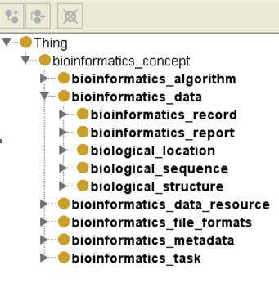
Semantic Web
Ontologies
Integral part of Semantic Web.
The specification of conceptualisations, used to help programs and humans share knowledge (Gruber, 1995).
Capture and computationally present knowledge shared by people in a certain community (Hadzic and Chang, 2004).
Represents a set of concepts (typically with precise definitions), which are mutually linked through a number of relationships.
Examples:

Slide 31
Courtesy
Following people’s lecture slides have also been consulted during the preparation of this lecture.
Dr. Rehan Rasool (SEECS)
Umar Kalim (Ex-SEECS)
Dr. Faisal Bashir (MCS)

Slide 32
Enough for Today

